Slide 1
Synergies between
transnational strategies
and European programmes
Pier Francesco Moretti
Tour of Europe: participation to horizon 2020, national structuring and organisation in Brussels CLORA – 26 May 2015

Slide 2
MOTIVATION
Why cooperating? Why sitting at some tables?
1a) critical mass (for competitive advantage)
1b) sharing competences (for collaborative advantage)
1c) avoiding duplications (reducing costs)
1d) tactical (indirect impact or patrol)

Slide 3
In this presentation: trans-national vs EU. - Cooperation at MS/EU level - Cooperation between levels - The issue of instruments/incentives

Slide 4
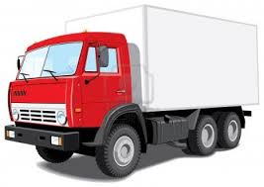
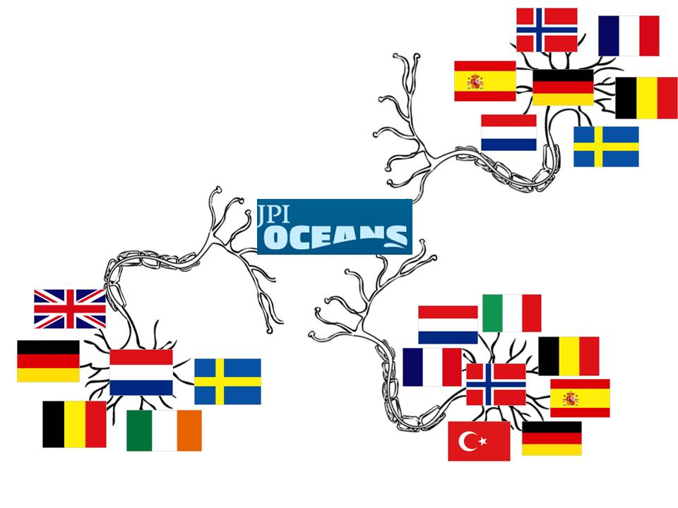
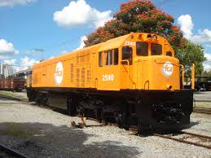
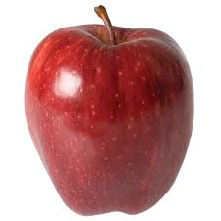
VISION/STRATEGY
About what and with whom? How?
Trans-national :
mostly bilateral…seldom multi-lateral
variable and adaptive geometry (no political blocks anymore...)
A simulation…

Slide 5
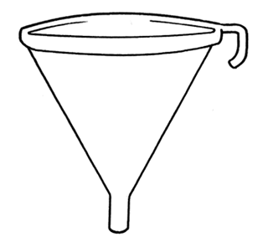
“Institutional” Europe: EC+EP+Council
What priorities?
How selected?
Averaging…
WEB et al.
ADVISORY GROUPS
(selected individuals)
CONSULTATION
Tech Platforms
Other
DGs
Programme
Committees
ERANETS, JPIs
Directives/
incentives?
(MS+AC)

Slide 6
Example: the Council…28 Member States…
Working Party 2
The Capitals
Working Party 1
Coreper
Working Party n
COMP
Council
Party 1
What about the decision flow for the EC?
EU often is a compromise…have in mind to lobby/negotiate

Slide 7
Strategies & programmes vs Joint Actions on a variable geometry
Addressing research levels and research fields
TOP-DOWN
(hierarchy)
BOTTOM-UP
(market/
self-organization)
New modes of
governance
POLICY
RES FUNDING ORG
RES PERFORMING ORG
RESEARCHERS + INFRASRUCTURES
complexity/diversity:
one size does not fit all…case by case adaptive strategies

Slide 8
d
d
d
d
d
d

Slide 9
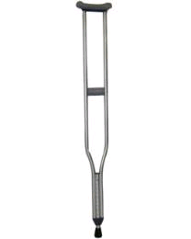
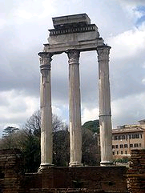
EXAMPLES of trans-national strategies vs EU programmes in RTD
Joint Programming
Initiatives
Possible no EU actions
Horizon 2020 (art. 183)
EU actions
Structural Funds
for R&D and innovation
National authorities
10 JPI=
Some G€/year?
Some G€/year
(fresh money)
>some G€/year?
SOCIETAL
CHALLENGES
Art. 185, ERANET…

Slide 10
Landscape vs strategy
In your country
Cooperating in EU
Competing in EU
Joint Programming
Initiatives
Possible no EU actions
Horizon 2020 (art. 183)
EU actions
Structural Funds
for R&D and innovation
in time

Slide 11
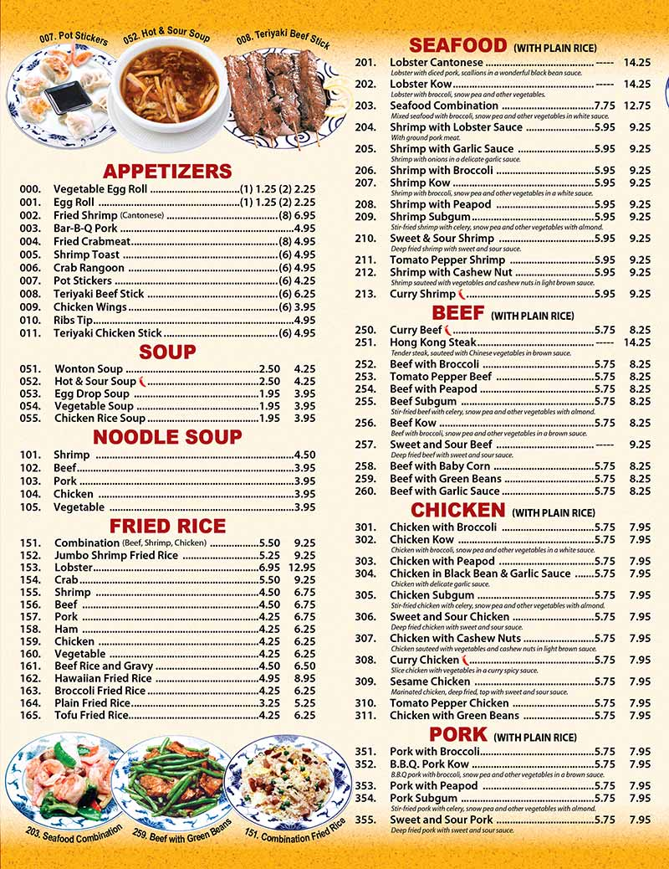
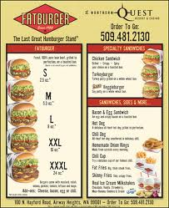
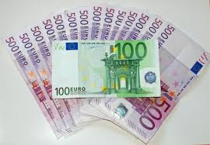
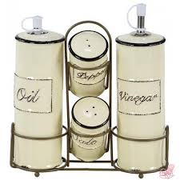
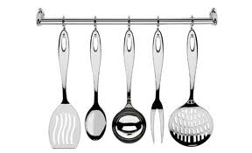
In practice: many Strategic Research and Innovation Agendas…? Technology Platforms, Alliances, JPIs, ERANETS ecc.
Shopping lists?
Common denominators?
Enablers?

Slide 12
We are addressing complex systems: how to linearize?...in a framework of missing strong/impacting high-level agreements?
instruments and glue money…
can make the difference
It is more probable that people, RPOs, RFOs, MS etc. will use/adapt the available and easiest tools/instruments with the largest budget:
see examples of “alignment” of instruments/programmes/initiatives: …JPI Climate+SC H2020+KIC
…JPI FACCE+SC H2020+EIP
Some sectors/activities are facilitated in matching national/eu

Slide 13
An example of complexity and trans-national cooperation also between levels with an EU instrument. A mixed cash/in-kind eranet cofund: H2020-SC5-2015-one-stage RFOs-RPO vs research teams/private sector

Slide 14
CSIC | CNR | DFG
ASCR | ASCR | ASCR
ASRT | ASRT | ASRT
BAS | BAS | BAS
CAS | CAS | AAS
CNR | CNR | CNR
CNRS | CNRS | CNRS
CNPq | CNPq | CNPq
CNRST | CNRST | CNRST
CONACYT | CONACYT | CONACYT
CSIC | CSIC | CSIC
JSPS | JSPS | JSPS
NSC | NSC | NSC
PAN | PAN | PAN
DFG |  | DFG
FCT | FCT
CONCYTEC | CONCYTEC
CONICET | CONICET
CONYCIT |  | CONYCIT
 | TUBITAK | TUBITAK
RAS | RAS
NSFC |  | NSFC
COLCIENCIAS |  | COLCIENCIAS
 | CASS | CASS
An example of fragmentation
without tools:
S&T bilateral agreements.

Slide 15
Alignment can be risky: “EU research programmes may widen gaps” Nature, 2015, 518, 167 Adapting to the majority…adapting to the EC…using the easiest tools…getting not closer to the target…

Slide 16
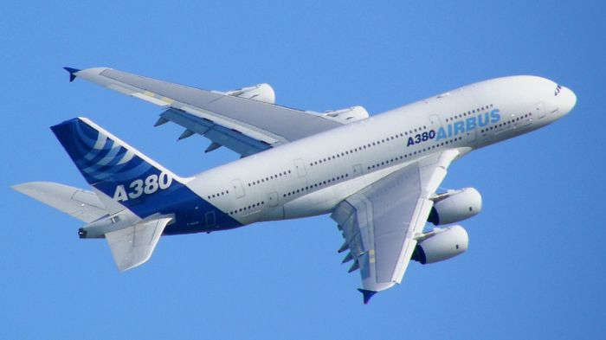
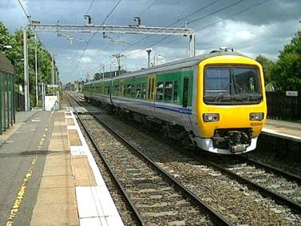
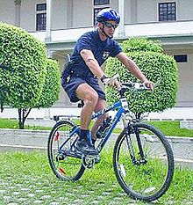
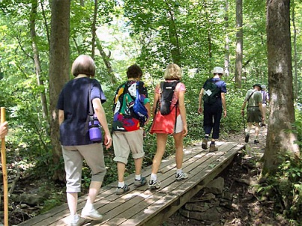
Alice in Wonderworld:
“if you do not know where you are going, how do you know when you get there…”
A traveler needs both a map and a compass.
But…
BUT…

